Slide 1
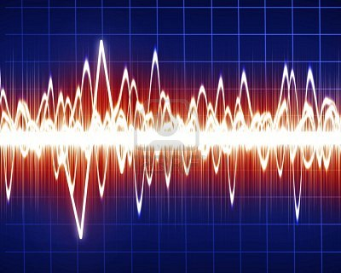
Waves and Wave Properties
6th grade science

Slide 2
Wave
Is any type of disturbance that carries energy
It may move matter, but DOES NOT carry it
Waves are moving energy

Slide 3
waves are created
When a source (force) creates a vibration.
Vibrations in materials set up wavelike disturbances that spread away from the source

Slide 4
How waves behave
Wave behavior can be described in the following ways:
1) How fast the disturbance spreads
2) Wavelength- the distance between successive peaks of the disturbance.
Waves move at different speeds in different materials

Slide 5
2 Main types of waves
1) Electromagnetic- Waves that can travel through empty space ie–Electromagnetic waves
they do not require a medium to travel
2)Mechanical-waves that must have matter (a medium) to travel through.
ie- Sound, earthquake( seismic waves)

Slide 6
Mechanical Waves
Mechanical waves must have a medium such as a solid, liquid or a gas (matter) to travel through.
They are all carrying energy, but what medium or matter do they travel through?
Waves at the beach- ocean or water
Sound waves from TV air
“The Wave” at a stadium people
Seismic waves that cause earthquakes ground or earth

Slide 7
Mechanical Waves 2 types*
1)Longitudinal waves
The motion of the medium is parallel to the motion of the wave
P waves are longitudinal
The energy is being carried by the wave back and forth.
The energy and matter
Are moving in the same direction

Slide 8
Longitudinal Waves*
Compression
When waves are close together
Rarefaction
When waves are far apart

Slide 9
Mechanical waves
2) Transverse Waves-The motion of the medium is perpendicular to the motion of the wave
Up and down waves
energy
The energy and matter are not moving in the same direction
The energy and matter move at a 90 degree angle.
S waves are transverse
medium

Slide 10
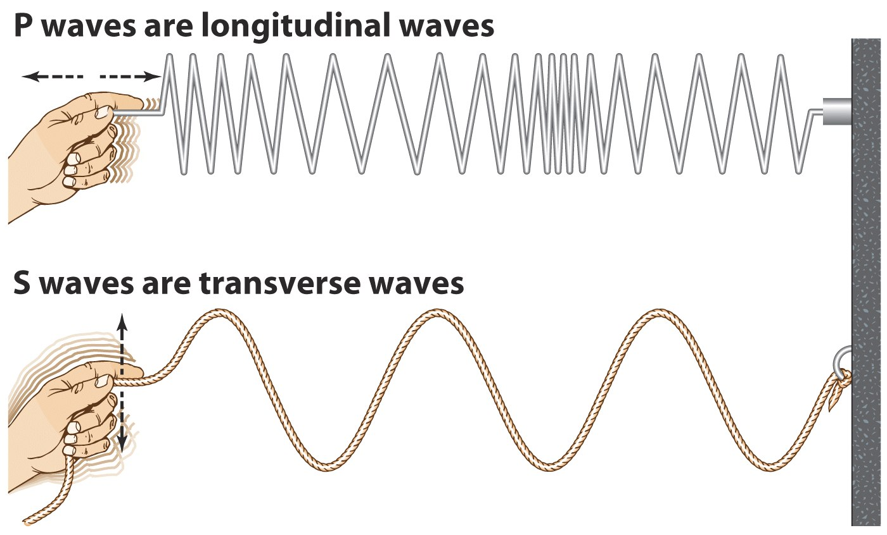
Another View

Slide 11
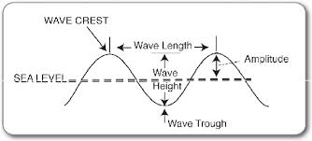
Parts of a wave

Slide 12
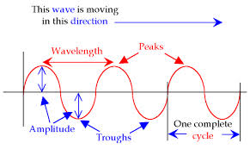
Parts of a wave

Slide 13
Transverse Waves*
Crest- highest point on a wave
Amplitude- Volume of a wave (height of a wave)
As wave height increases, volume increases
Measured in Decibels
Trough- lowest point on a wave
Frequency- Pitch, high or low (length of a wave)
As wavelength increases, pitch decreases
Measured in Hertz

Slide 14
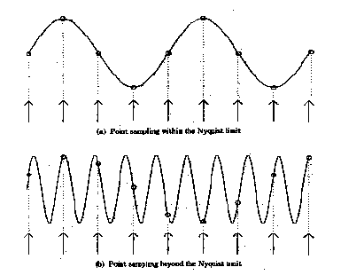
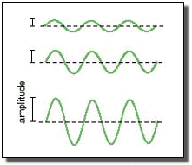
Amplitude versus Frequency
Amplitude
Which one will have the higher volume?
Frequency
Which one will have the higher pitch?

Slide 15
What can you hear?
Decibels (dB): Volume
Normal Speech: 60dB
Library: 40dB
Close Whisper: 20dB
Jet Engine: 140dB
Loud Rock Music: 110dB
Subway Train: 100dB
Busy Street Traffic: 70dB
120dB or above usually causes pain to the ear
Hertz (Hz): Pitch
Young people can hear frequencies between 20-20,000 Hz
Dogs can hear frequencies that range from 67-45,000 Hz
As you age, your ability to hear high frequency sound decreases.

Slide 16
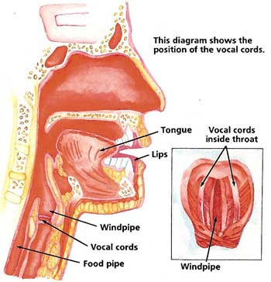
Vocal Cords
Two bands of muscle tissue within the larynx. These muscles vibrate to produce the voice.

Slide 17
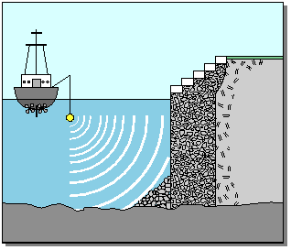
Sound travels faster through water than air!*

Slide 18
Diagram of a Transverse Wave*
AMPLITUDE
CREST
TROUGH
WAVELENGTH

Slide 19
How the Ear Works
6th Grade Science

Slide 20
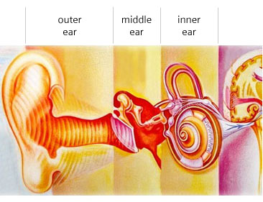
Parts of the Ear
The ear is divided into 3 main parts:
Outer Ear
Middle Ear
Inner Ear

Slide 21
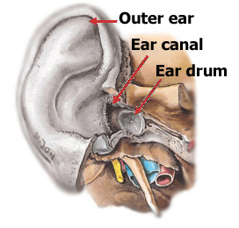
The Outer Ear*
Contains: pinna (lobe), ear canal, & ear drum.

Slide 22
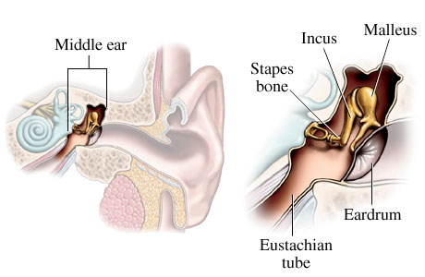
The Middle Ear*
Contains 3 bones: hammer, anvil, & stirrup.

Slide 23
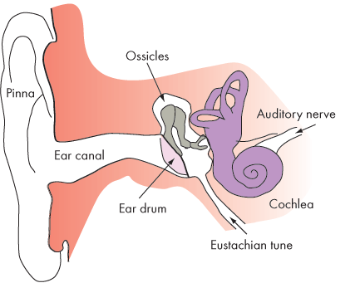
The Inner Ear*
Contains: cochlea and auditory nerve.

Slide 24
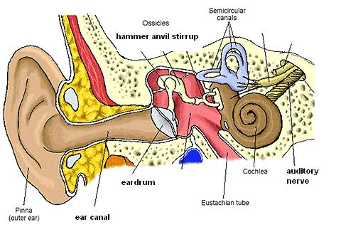
Label the Parts of the Ear*
Outer Ear
Middle Ear
Inner Ear
Hammer
Anvil
Stirrup
Eardrum
Cochlea
Auditory
Nerve
Pinna
Ear Canal

Slide 25
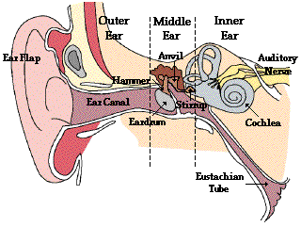
How Does the Ear Work?
Animation 1
Animation 2
Animation 3

Slide 26
Steps to Hearing:*
Vibrations move through the outer ear canal and vibrate the eardrum.
The eardrum passes its energy through a chain of three tiny bones, the anvil, hammer, and stirrup, in the middle of the ear.
The anvil, hammer, and stirrup pass the energy onto the cochlea.
The vibrations activate hair cells and fluid inside the cochlea.
Electrical signals are sent to the brain through the auditory nerve.

Slide 27
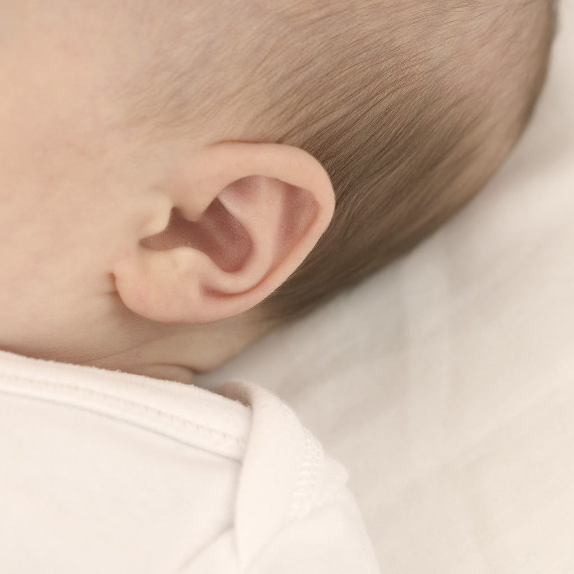
Video on how the ear works:

