Slide 1
Land Unit: Plate Tectonics
Cornell Notes

Slide 2
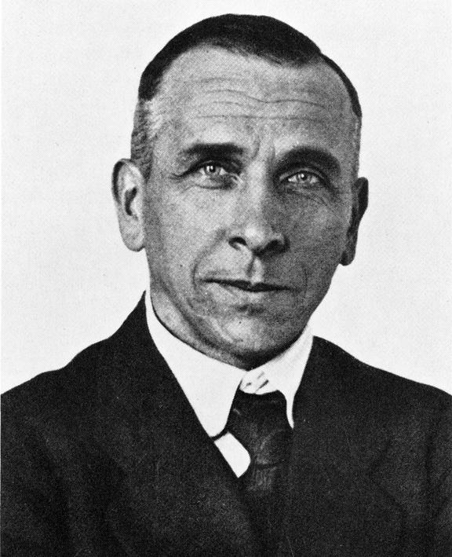
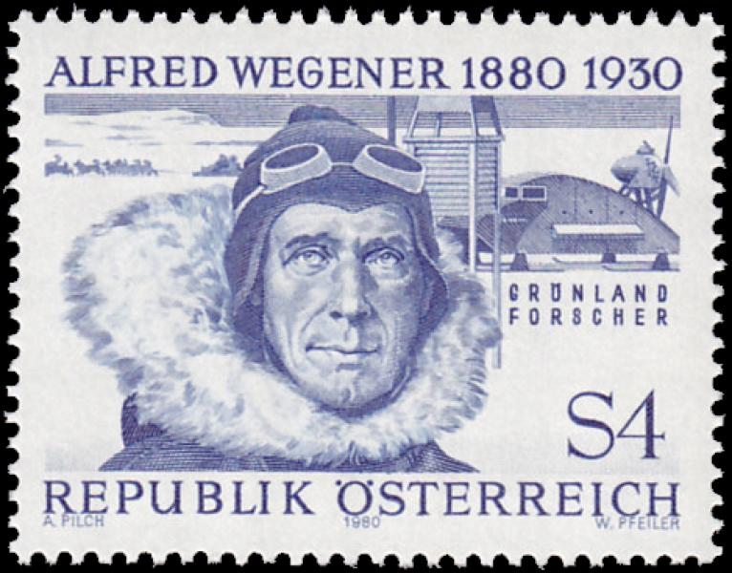
Who is Alfred Wegener?
A German scientist who hypothesized the theory of continental drift.

Slide 3
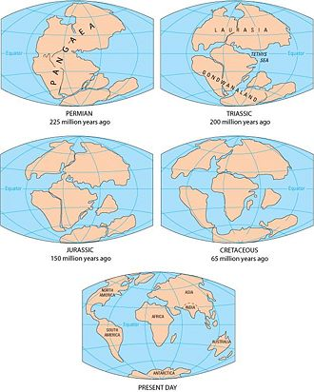
What is the Theory of Continental Drift?
A hypothesis that all the continents were once
joined together in a single land mass called
Pangaea and has since drifted apart.

Slide 4
What evidence supports this hypothesis?
1. Land Features:
-He noticed that the mountain ranges on the continents of Africa and South America line up.
2. Fossils:
-Fossils-trace of an ancient organisms that has been preserved in rock.
-Dinosaur fossils have been found in landmasses separated by oceans.
3. Climate:
-Evidence of tropical plants has been found in the Arctic Ocean and glacier evidence in South Africa.

Slide 5
Why wasn’t Alfred Wegner’s Theory Accepted?
-Alfred Wegner had a lot of evidence to support his theory.
-He could not explain how the plates moved.
-Because he could not explain how the plates moved, scientist did not accept his theory.

Slide 6
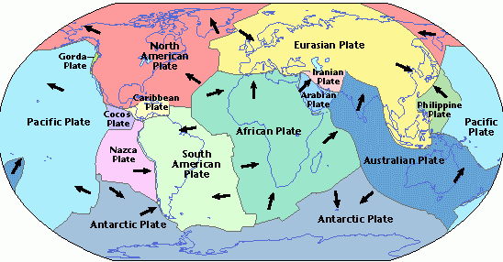
What is the Theory of Plate Tectonics?
-Pieces of Earth’s lithosphere are in slow, constant motion
-Movement is caused by convection currents in the mantle.
-Plates move in three types of behavior
-Tectonic plates are made of
continental and oceanic crust

Slide 7
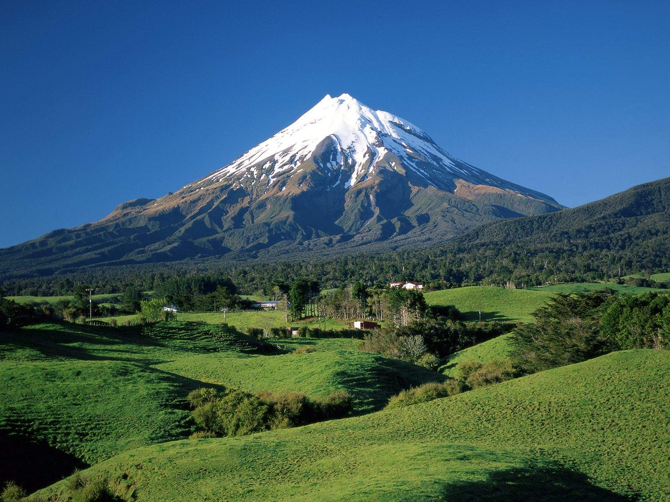
What is a convergent boundary and where does it occur?
-Place where two plates come together, or converge.
-A “collision”
-Forms mountains and volcanoes
-When oceanic crust slips under
continental crust: SUBDUCTION
-Subduction forms volcanoes

Slide 8
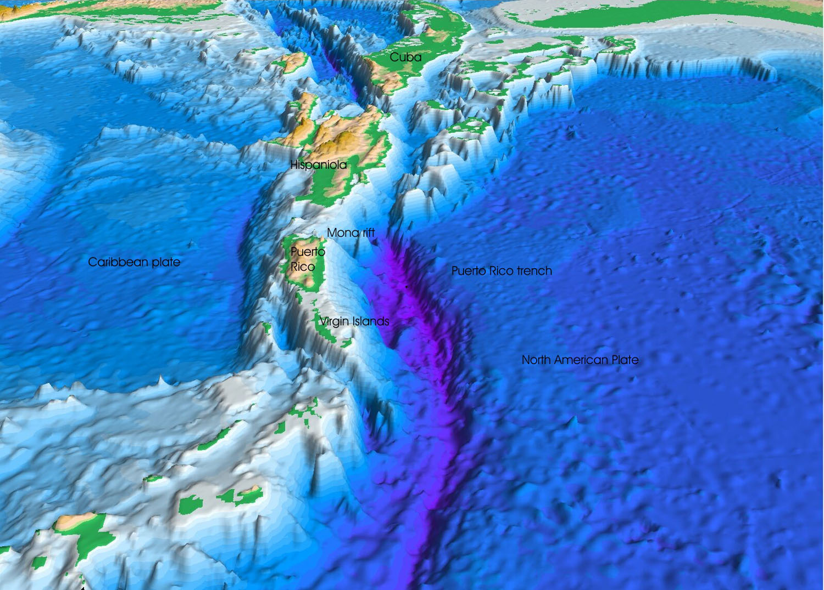
What is a divergent boundary and where does it occur?
-Place where two plates spread apart; or diverge.
-Molten material moves up between the plates
and forms new ocean floor, rift valleys, ocean trenches.

Slide 9
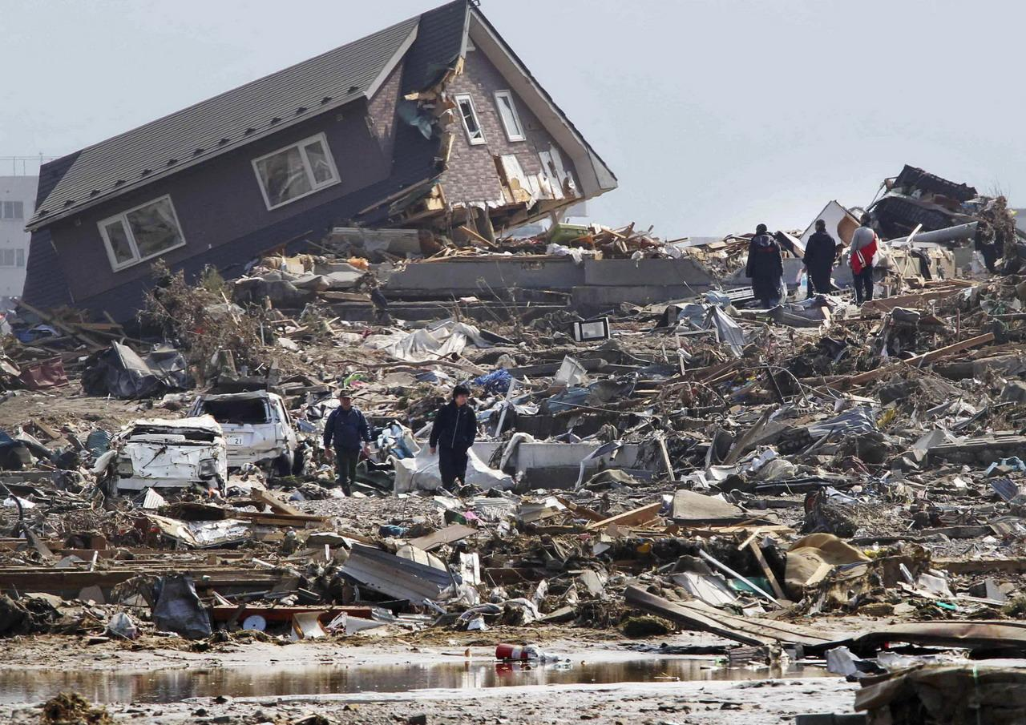
What is a transform boundary and where does it occur?
Where two plates slide past each other in opposite directions.
Earthquakes occur when two plates slide past each other.

