Slide 1
Plate Tectonics
The Three Types of Boundaries
6th Grade, Wendell Middle

Slide 2
Jigsaw Work
Create the following table in your notebook:
Divergent | Convergent | Transform

Slide 3
Jigsaw Work
Read about your assigned boundary on the following pages:
Divergent: p. B83-88
Convergent: p.B90-93
Transform: p.B94-96

Slide 4
Jigsaw Work
Describe what happens to the plates at your boundary.
What landform do we find at the boundary?
What happens to the crust at the boundary?
Sketch what it looks like.
List other interesting or important facts.

Slide 5
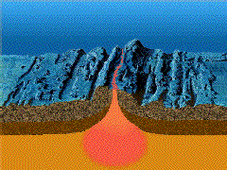
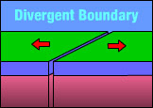
Divergent Boundary
Occurs where plates move apart or DIVIDE
As plates move apart, magma is released between the land masses
New crust is formed
Volcanoes are created

Slide 6
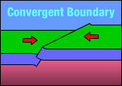
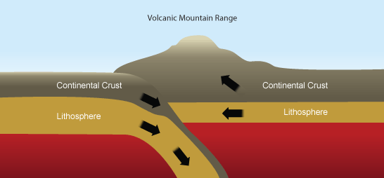
Convergent Boundary
Occurs where plates push together or COLLIDE
Crust is folded or destroyed
Mountains are formed

Slide 7
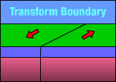
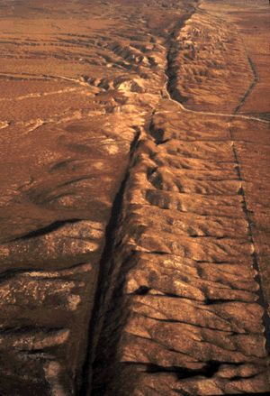
Transform Boundary
Occurs where plates scrape past each other or SLIDE
Crust is not created or destroyed
Can cause earthquakes and tsunamis

Slide 8
Video on Boundaries

